Slide 1
Adaptive H.I.D.
Viability Review of Low Cost, Libre
Adaptive Human Interface Devices
to Modern Computers
CPE 496-01
Michael Baldwin
Christopher Bero
John Gould
Bryant Johnson
Notes:
### Bryant ###
Hello, We are Team Adaptive H.I.D. Before we begin we will be passing around one of our prototypes for you to see. Additionally, we will be conducting the presentation with another one of our prototypes.
With that, We are presenting to you today: A Viability Review of Low Cost Libre Adaptive Human Interface Devices to Modern Computers

Slide 2
Team Members
Mike Baldwin
Software Lead, Systems Interface
Christopher Bero
Hardware Lead, Microcontrollers
John Gould
Systems Lead, Technical Writer
Bryant Johnson
Testing Lead, Community Outreach
Notes:
### Bryant ###

Slide 3
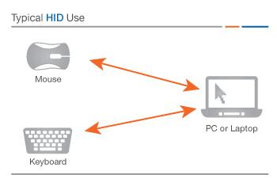
Background
Adaptive Technology (A.T.)
A device or component which is specifically designed for persons living with disabilities.
Human Interface Device (H.I.D.)
A tool by which a user interacts with an electronic information system either by input or output.
Notes:
### Bryant ###
So to give a bit of a background, We want to recap on the terms used. Adaptive Technology is a device or component which is specifically designed for persons living with disabilities.
This can be Low tech like a foam gripper on a pencil
Or high tech such as eye movement tracking devices
and Human Interface Devices or HID This is a tool by which a user interacts with electronic information either by input or output.
Such examples include: Keyboard, Mouse, game controller, touch screens. Etc

Slide 4
Project Summary
Our project is to research and design an adaptive interface device for modern computers. The device will have a focus on affordability, iterative design, and easy operation. Construct and test the device for viability in general use; then generate a case study on the effectiveness of this approach to bringing adaptive technology to a larger audience.
Notes:
### Bryant ###
So the focus of our project is to develop an adaptive interface device for modern computers
Must be affordable
Have an iterative design
And easy to operate.
We wanted to create a viable adaptive technology solutions to a larger audience.

Slide 5
Community
We have reached out to:
UCP - United Cerebral Palsy
NFB - National Federation for the Blind
UAH DSS - Disability Support Services
AIDB - Alabama Institute for Deaf and Blind
BristolBraille - RBD design team
UCP / TASC provided our initial product design review on Nov. 5th and provided additional evaluation for the final design.
Notes:
### Bryant ###
For our project, we reached out to many different organizations. Listed Here However, we were thankful to have TASC at UCP to provide us with our design review and evaluations throughout the course.

Slide 6
Customer
Our team has been interfacing with TASC at UCP Huntsville.
TASC - Technology Assistance for Special Consumers
The mission of TASC is to provide individuals with disabilities, their families and/or advocates, and associated professionals access to assistive technology devices and services to increase independence
Notes:
To give a little background on our customer: TASC stands for Technology Assistance for Special Consumers
Their mission is to provide individuals access to assistive technology devices and services to increase independence.

Slide 7
Design Approach
We first chose a target audience and decided on appropriate engineering and marketing requirements. From these requirements we drafted a basic design and drew the various parts we needed in FreeCAD and Inkscape.
We used FreeCAD and OpenSCAD to design any parts that needed to be 3D printed.
Inkscape was used to design the parts being cut by the laser cutter.
Notes:
### Bryant ###
For our Design Approach: We wanted to choose a target audience that can benefit from our products.
The various parts of our project was created by utilizing 3D printers and a laser cutting bed.
For 3D Printing we used FreeCad and OpenSCAD
For Laser Cutting we used Inkscape

Slide 8
Development Process
Our initial systems design based elements on strict functionality (does it work).
We then entered a construction and revision cycle: the team would assemble a prototype and present it to our customer, TASC, for review. TASC would then give us new ideas and changes which we investigated and added to the next iteration.
Notes:
### Bryant ###
The Development Process for the project could be seen as similar to Agile.
We would have a construction cycle and assemble the prototype. Then we will present it to TASC for review. TASC will give suggestions and ideas for us to implement in the next iteration.

Slide 9
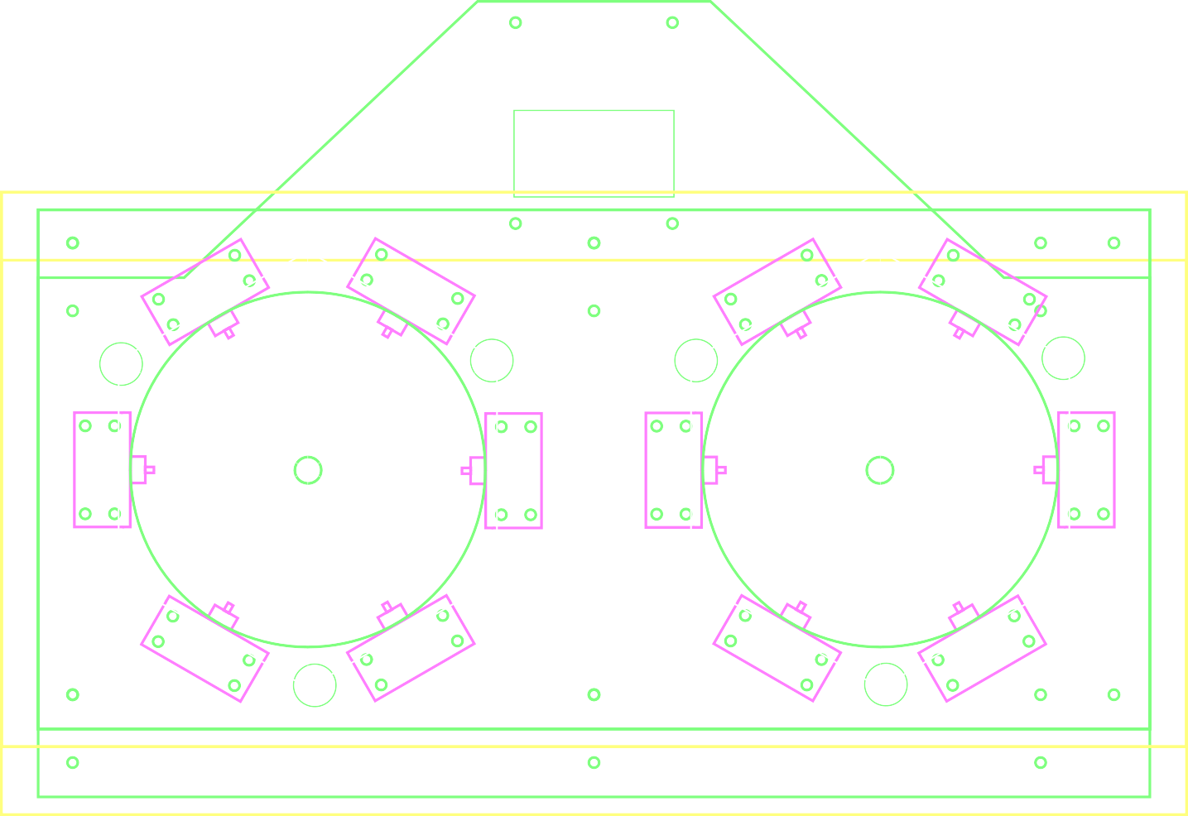
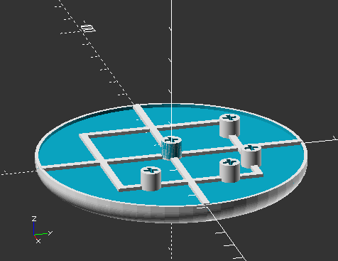
Proposed Systems
Sliding Keyboard
Reduce the dexterity required for text input by utilizing two large control surfaces.
AT Button
Provide an easy to reproduce, low cost alternative solution for implementing a basic switch for adapting other products for AT solutions.
Software Package
Improve the state of A.T. interface software for computers.
Notes:
### Bryant ###
For our Project, We had three systems that we will go over more in depth. Shortly As an overview, we developed a sliding keyboard that lowers the dexterity required to input text
An AT Button that was created at the Request of our Customer at TASC.
And Learning software application that is similar usage to your cell phone and automatically suggests words.

Slide 10
Marketing Requirements
Open Source Design
Require only items available to common makerspaces
Easy to iterate and customize
Low cost requirements for parts and machinery
Easy to Operate
Must provide as good or better functionality than existing solutions
Reliable
Must accept improper input and have a robust mechanical design
Notes:
### Bryant ###
To reiterate the goals of the project:
Open source
Therefore cheap and makes use of readily available materials and techniques.
Accessible for people to build, and modify.
Easy to Operate
With equivalent or better functionality of existing devices
Reliable
Design should be durable.

Slide 11
Engineering Requirements
Hardware bounce time during activation < 6ms
10 Million Cycle Lifetime
Operation [1]
30 Words Per Minute
90% Typing Accuracy
Operating Temperature: 0C – 45C (32F-113F)
Materials
Thermoplastics – Case, Mounts
Stainless Steel – Springs, Case
Rubber – Non-slip Footings
Notes:
### Bryant ###
The Engineering Requirements are directly influenced by the desire to be reliable. So we made our goal to adhere to the standards set up by the alternatives
Such as long lifetime components
Use of proven materials.
Now I will hand it off to Chris to talk more in depth of our hardware.

Slide 12
AT Keyboard
Design Goals
Make keyboard and/or mouse input easier.
I.E. Remove the “fine” motor control,
Keyboard used with shoulder/elbow.
Assemble with workshop tools:
Export to DXF and laser cut, or
Render to toolpath and CNC route, or
Print to paper and cut by hand.
Oh, and make it cheap!
Notes:
### CHRIS ###
Design goals:
Make the keyboard a tool for input, not an obstruction.
This keyboard can be operated with the shoulder and elbow.
Create files such that the keyboard can be made by:
laser
CNC
by hand
And make it cheap.
Next: How to use it

Slide 13
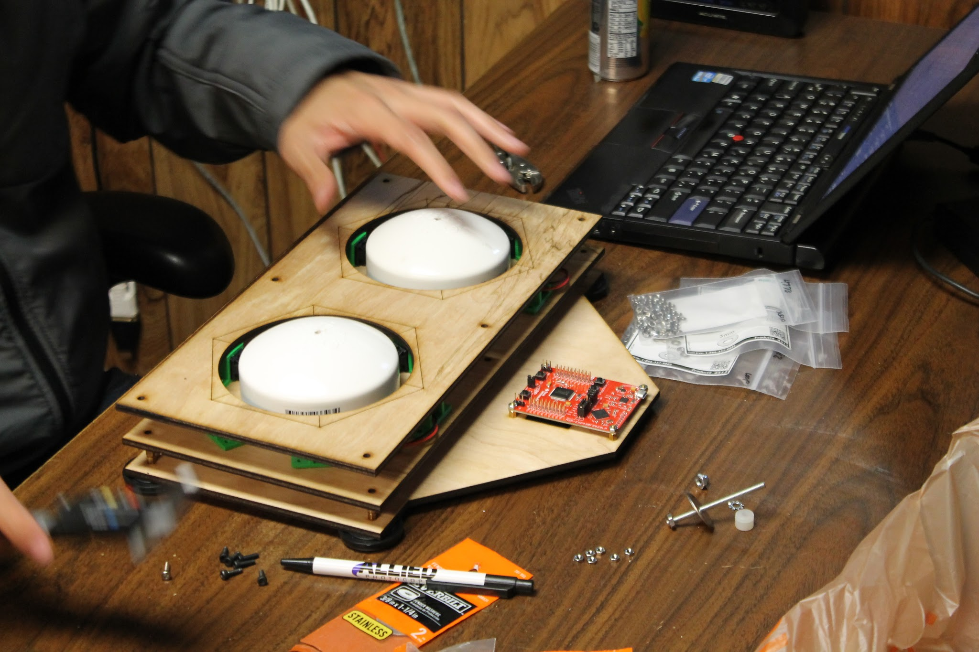
AT Keyboard
Operation
Notes:
### CHRIS ###
Let’s quickly review how to operate the AT Keyboard

Slide 14

AT Keyboard
Operation
Notes:
### CHRIS ###
To begin, you have two octogonal switch rings with paddles situated inside them.
The paddles are moved to connect with an apex of the octogon.

Slide 15
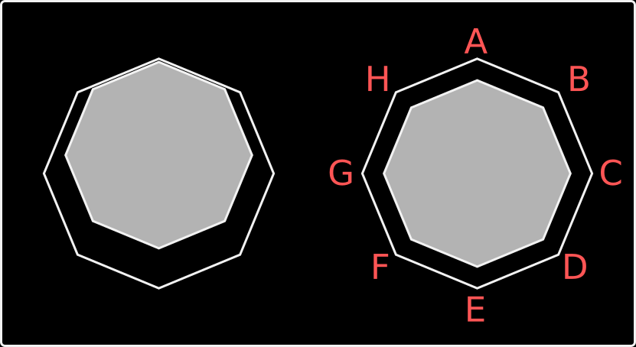
AT Keyboard
Operation
Notes:
### CHRIS ###
The first (left) paddle is moved to select a group.
This group is the characters A through H.

Slide 16
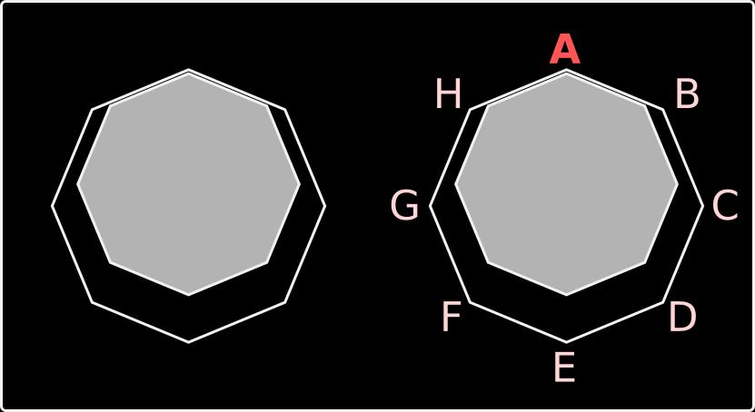
AT Keyboard
Operation
Notes:
### CHRIS ###
The second paddle is then moved to select a character. The process is repeated to type.
Next: Orbitouch

Slide 17
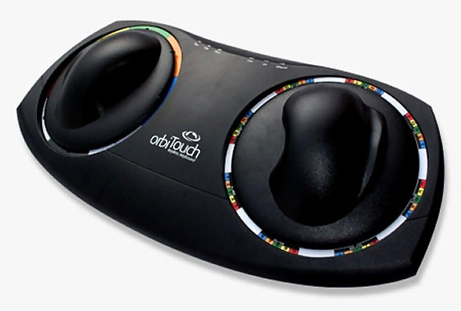
Existing Products
Orbitouch Keyboard
Retails for ~$450
Eight sections per paddle.
Also simulates mouse.
… Has patents?
Notes:
### CHRIS ###
This is an existing product that shares a similar user experience with our keyboard.
The Orbitouch by Blue Orb Inc. retails for a little over $400 and also has 8 keys per handle.
Blue Orb Inc also owns several patents referring to the keyboard.
Next: our findings from the patents

Slide 18
Existing Products
In lieu of any legal advice available to students, we read all of Blue Orb Inc’s listed patents.
They all appear to describe internal mechanisms of the keyboard.
We moved to have our AT Keyboard use the keymap of the Orbitouch.
Jumped from 12 to 16 keys halfway through the design process.
Notes:
### CHRIS ###
We aren’t very good lawyers, but the team read through all of the patents to see if we could even proceed building our keyboard.
It looks like most of the patents pertain to mechanical design, and so we regained interest in having our AT Keyboard share the same keymap with the Orbitouch. This way the two can be used side by side.
Next: Initial changes (keyboard prototype 2)

Slide 19
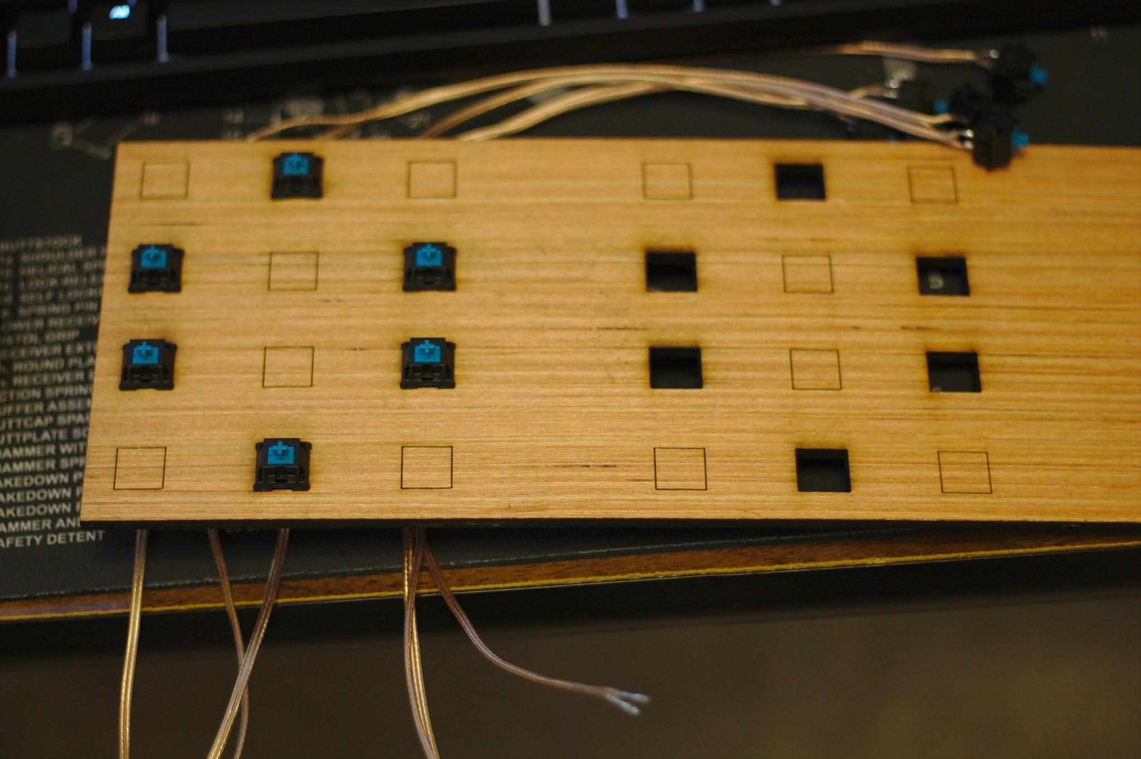
Testing and Revision
Internal testing beforehand:
Smaller keyboard
Higher actuation force
Side mounted switches
Laser/toolpath/router format decisions
Notes:
### CHRIS ###
We started with an initial prototype that had a very large base, expecting the mechanism to be large.
internal testing and review brought us some changes:
Smaller
Increased actuation force
Make keys side mounted
Multi-path files (laser, cnc, hand)
Next: Switch layout

Slide 20
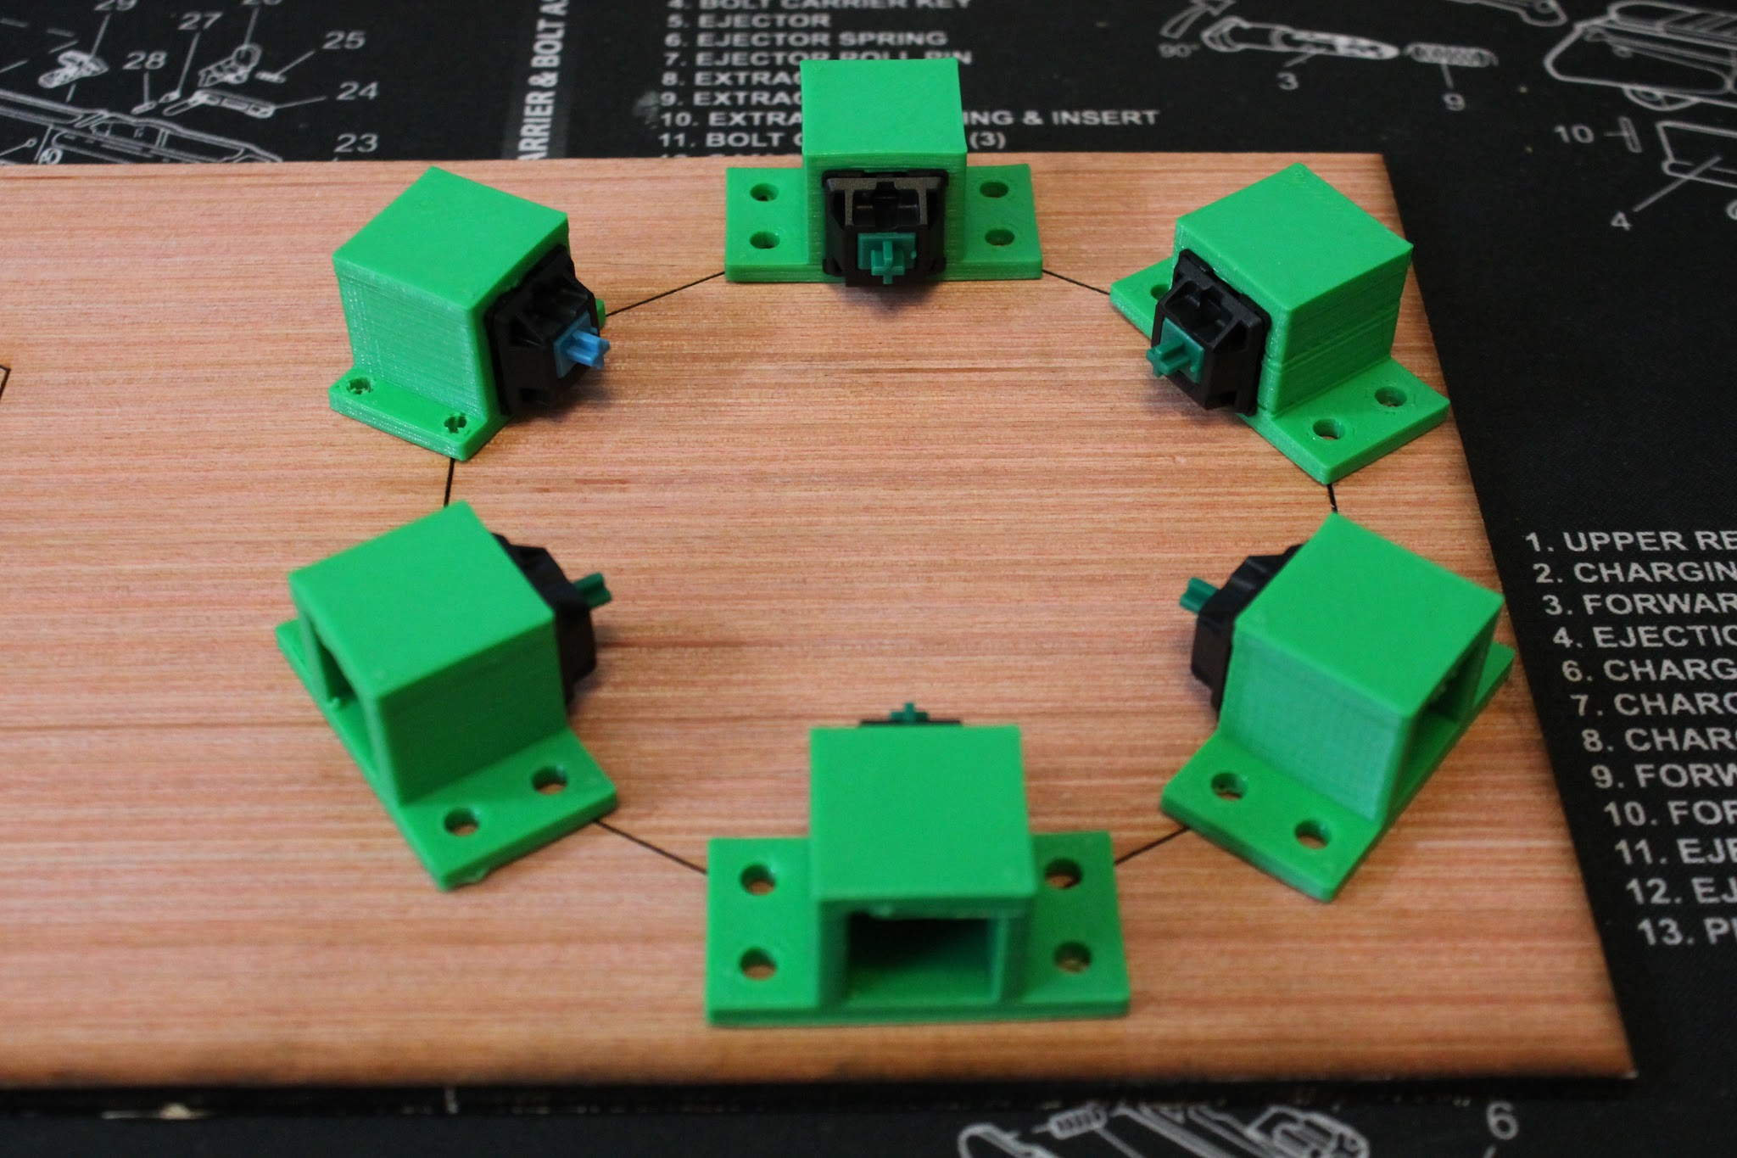
Testing and Revision
Internal testing beforehand:
Notes:
### CHRIS ###
Here is an early switch layout
Next: First design review (prototype 3)

Slide 21
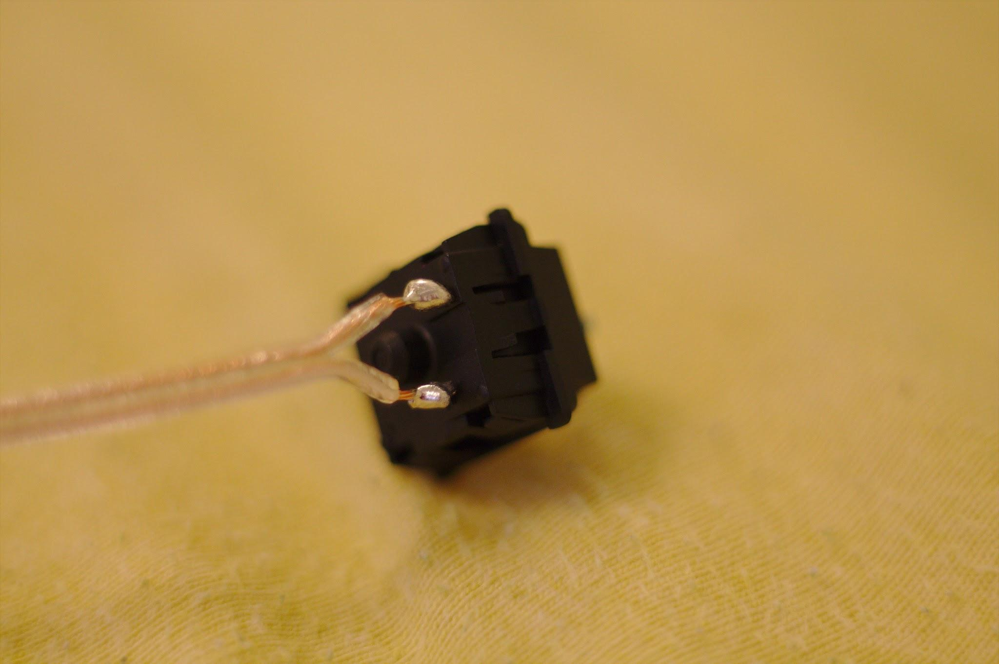
Testing and Revision
First design revision:
Lower actuation force
Smaller actuation distance
Smaller keyboard base
Notes:
### CHRIS ###
Our first meeting with TASC went very well. They had the following changes for us to make:
Lower actuation force
Smaller actuation distance
Smaller Keyboard base
Next: Wire harness

Slide 22
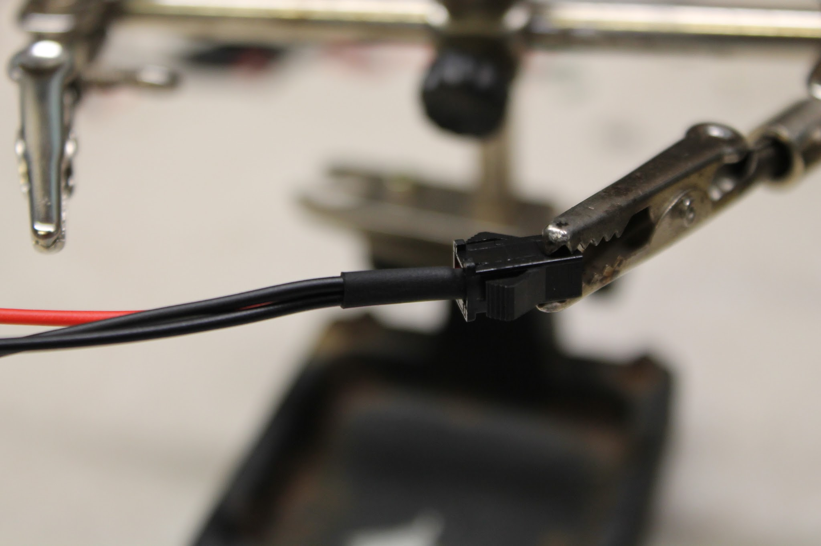
Testing and Revision
First design revision:
Notes:
### CHRIS ###
We quickly learned that the previous method of soldering directly to the switches would cause trouble,
(next slide)

Slide 23
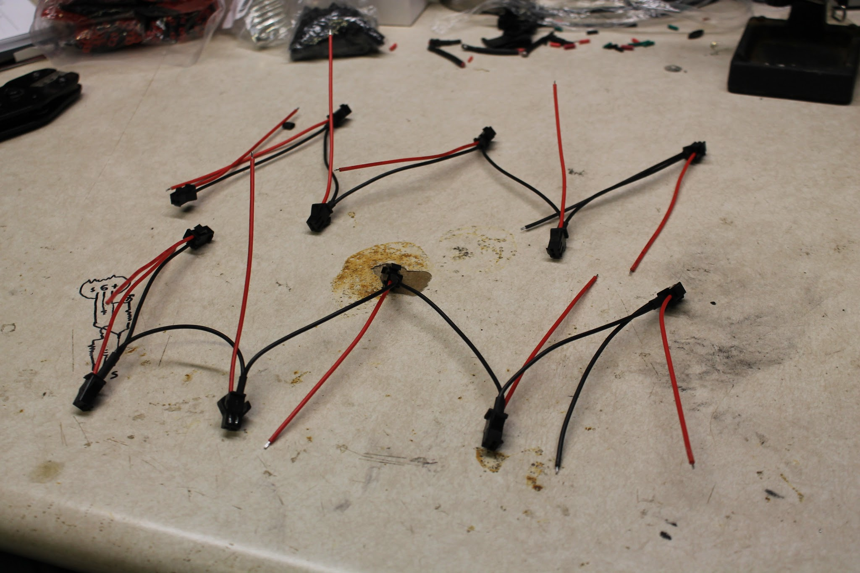
Testing and Revision
First design revision:
Notes:
### CHRIS ###
So we built a wiring harness which allows for fast re-arrangement and re-use of switches.
Next: wire harness and first mounting plate

Slide 24
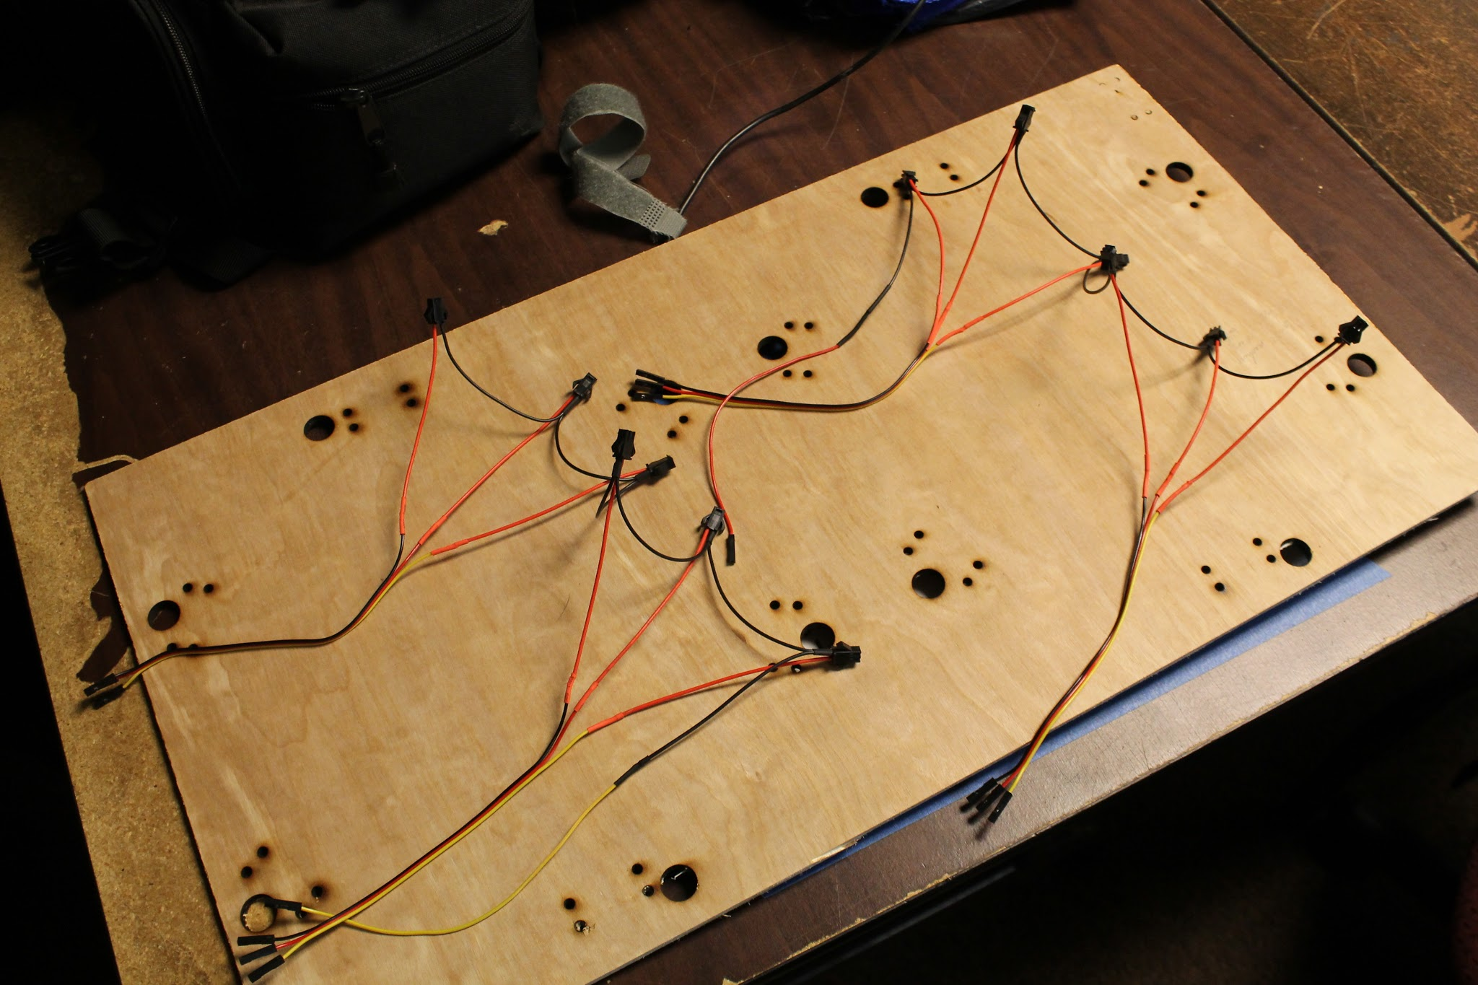
Testing and Revision
First design revision:
Notes:
### CHRIS ###
We then set to making this third keyboard prototype.
Here is a laser cut mounting plate along with the wiring harness.
Next: center springs

Slide 25
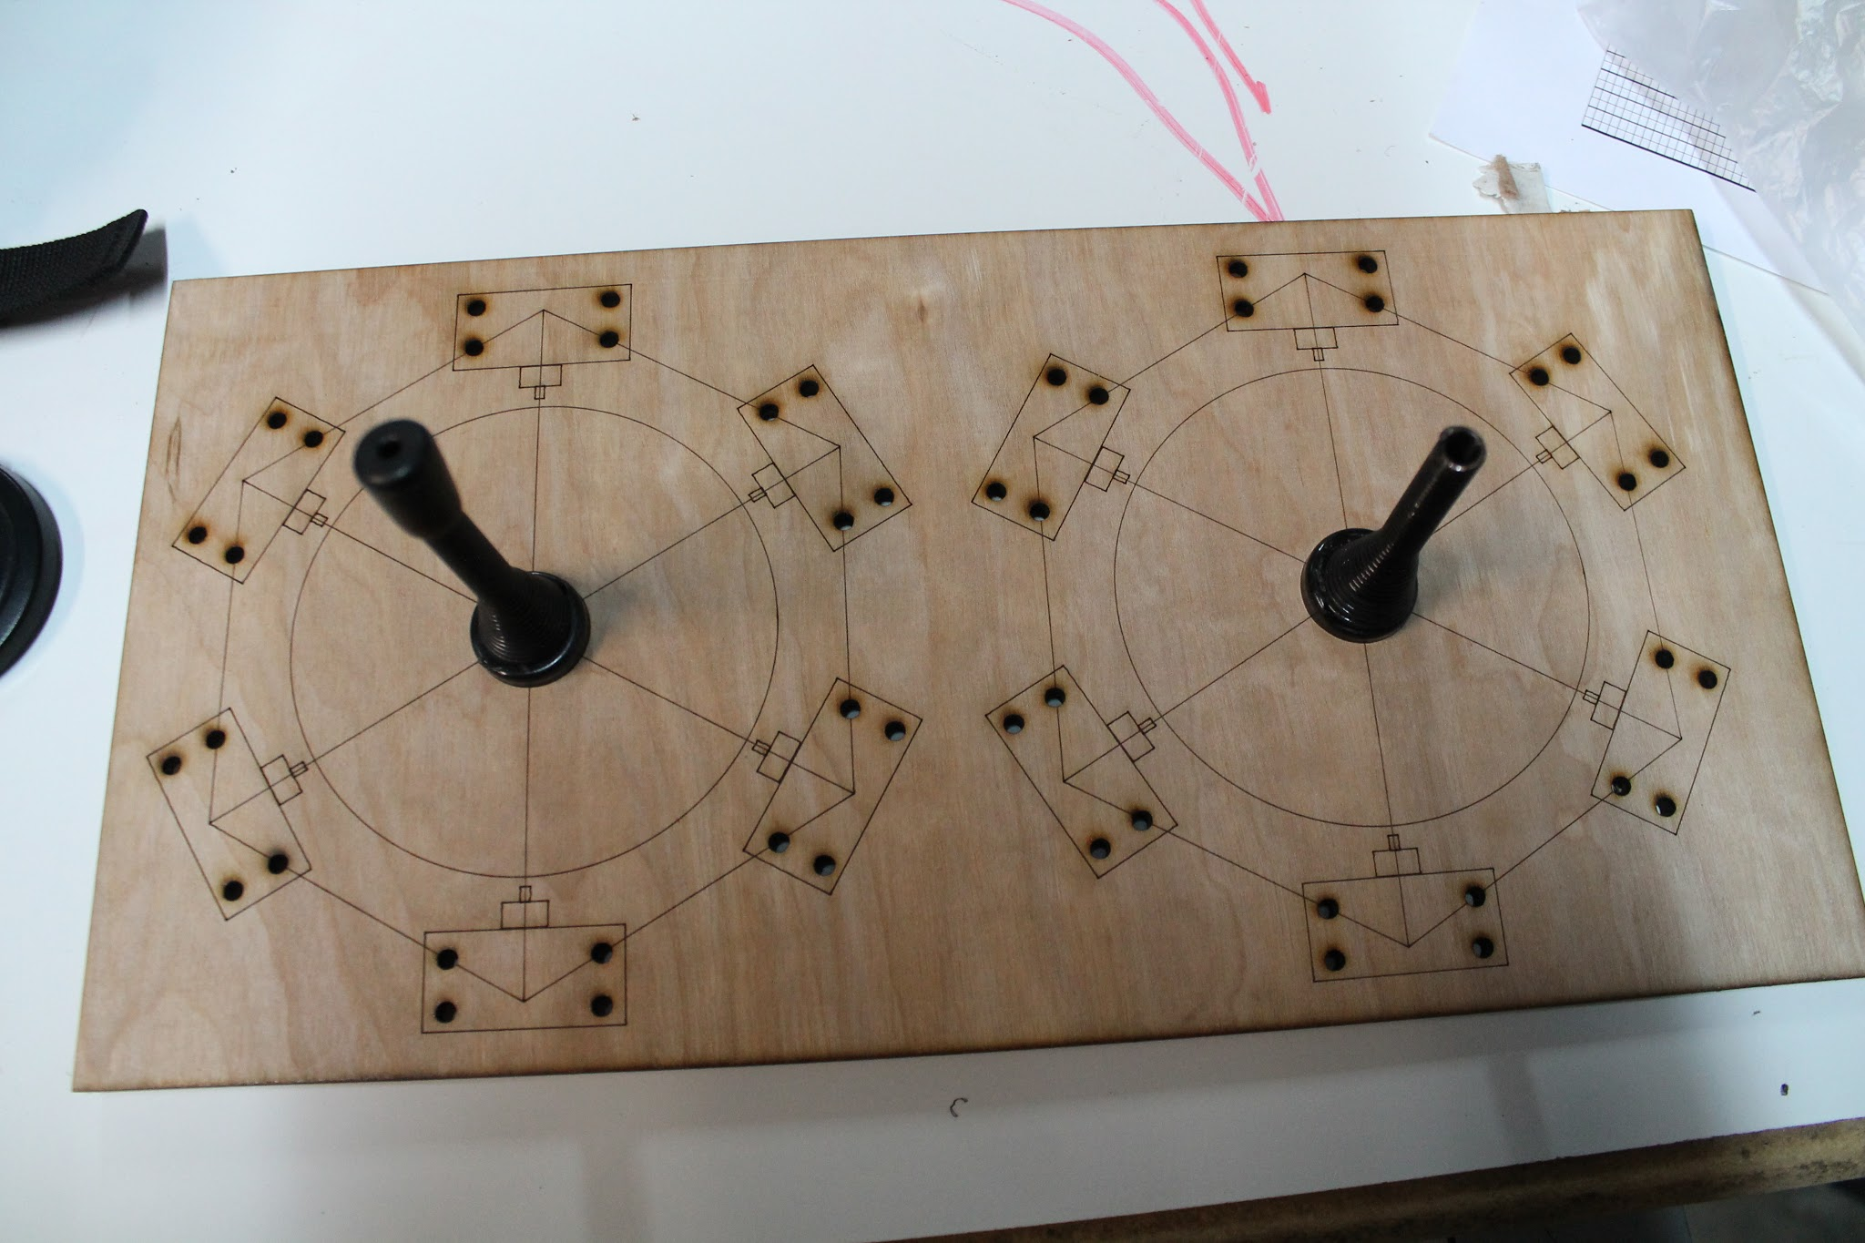
Testing and Revision
First design revision:
Notes:
### CHRIS ###
We also investigated using springs to center the paddles.
Next: 3rd prototype layout

Slide 26
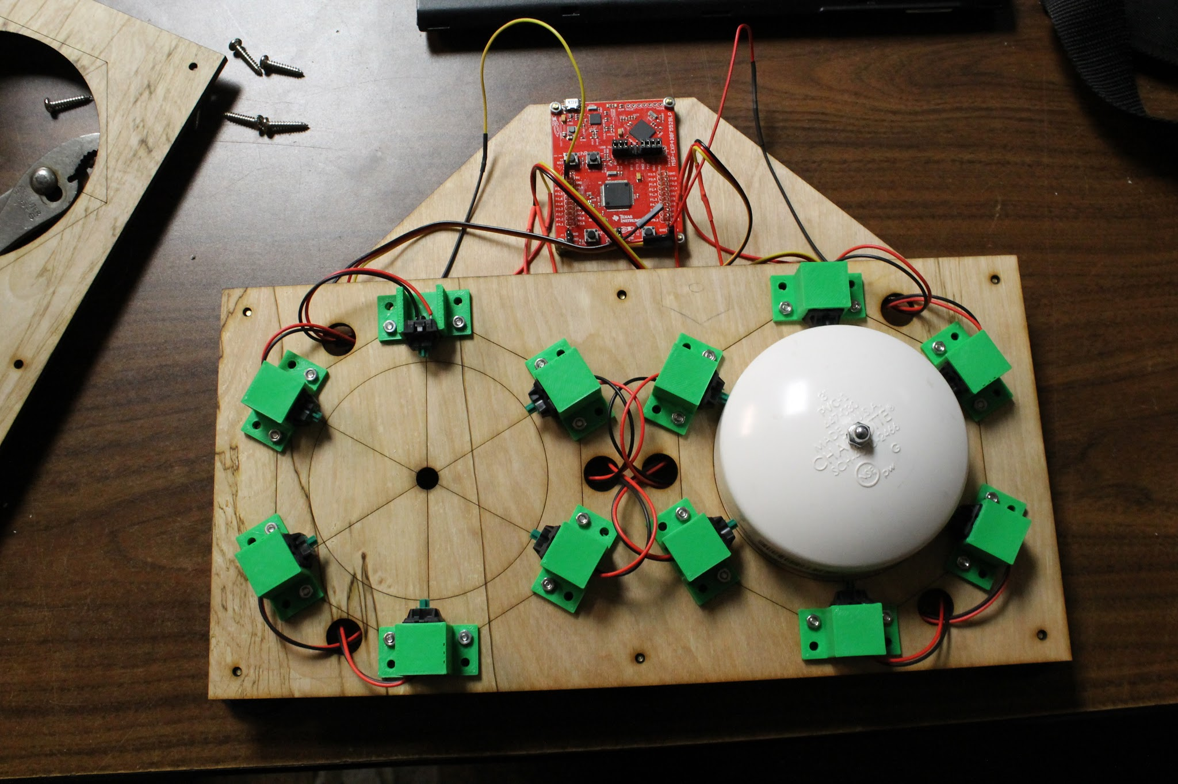
Testing and Revision
First design revision:
Notes:
### CHRIS ###
Here is the third keyboard prototype brought to TASC for review and testing.
Next: second design review

Slide 27
Testing and Revision
Second design revision:
Rotate switch layout
Increase paddle spacing
Adjust debounce
Adjust actuation force
Notes:
### CHRIS ###
TASC brought in an additional associate in the field to help us gather user testing data and additional design changes.
We went back to the drawing board with these changes.
Next: Laser broke

Slide 28
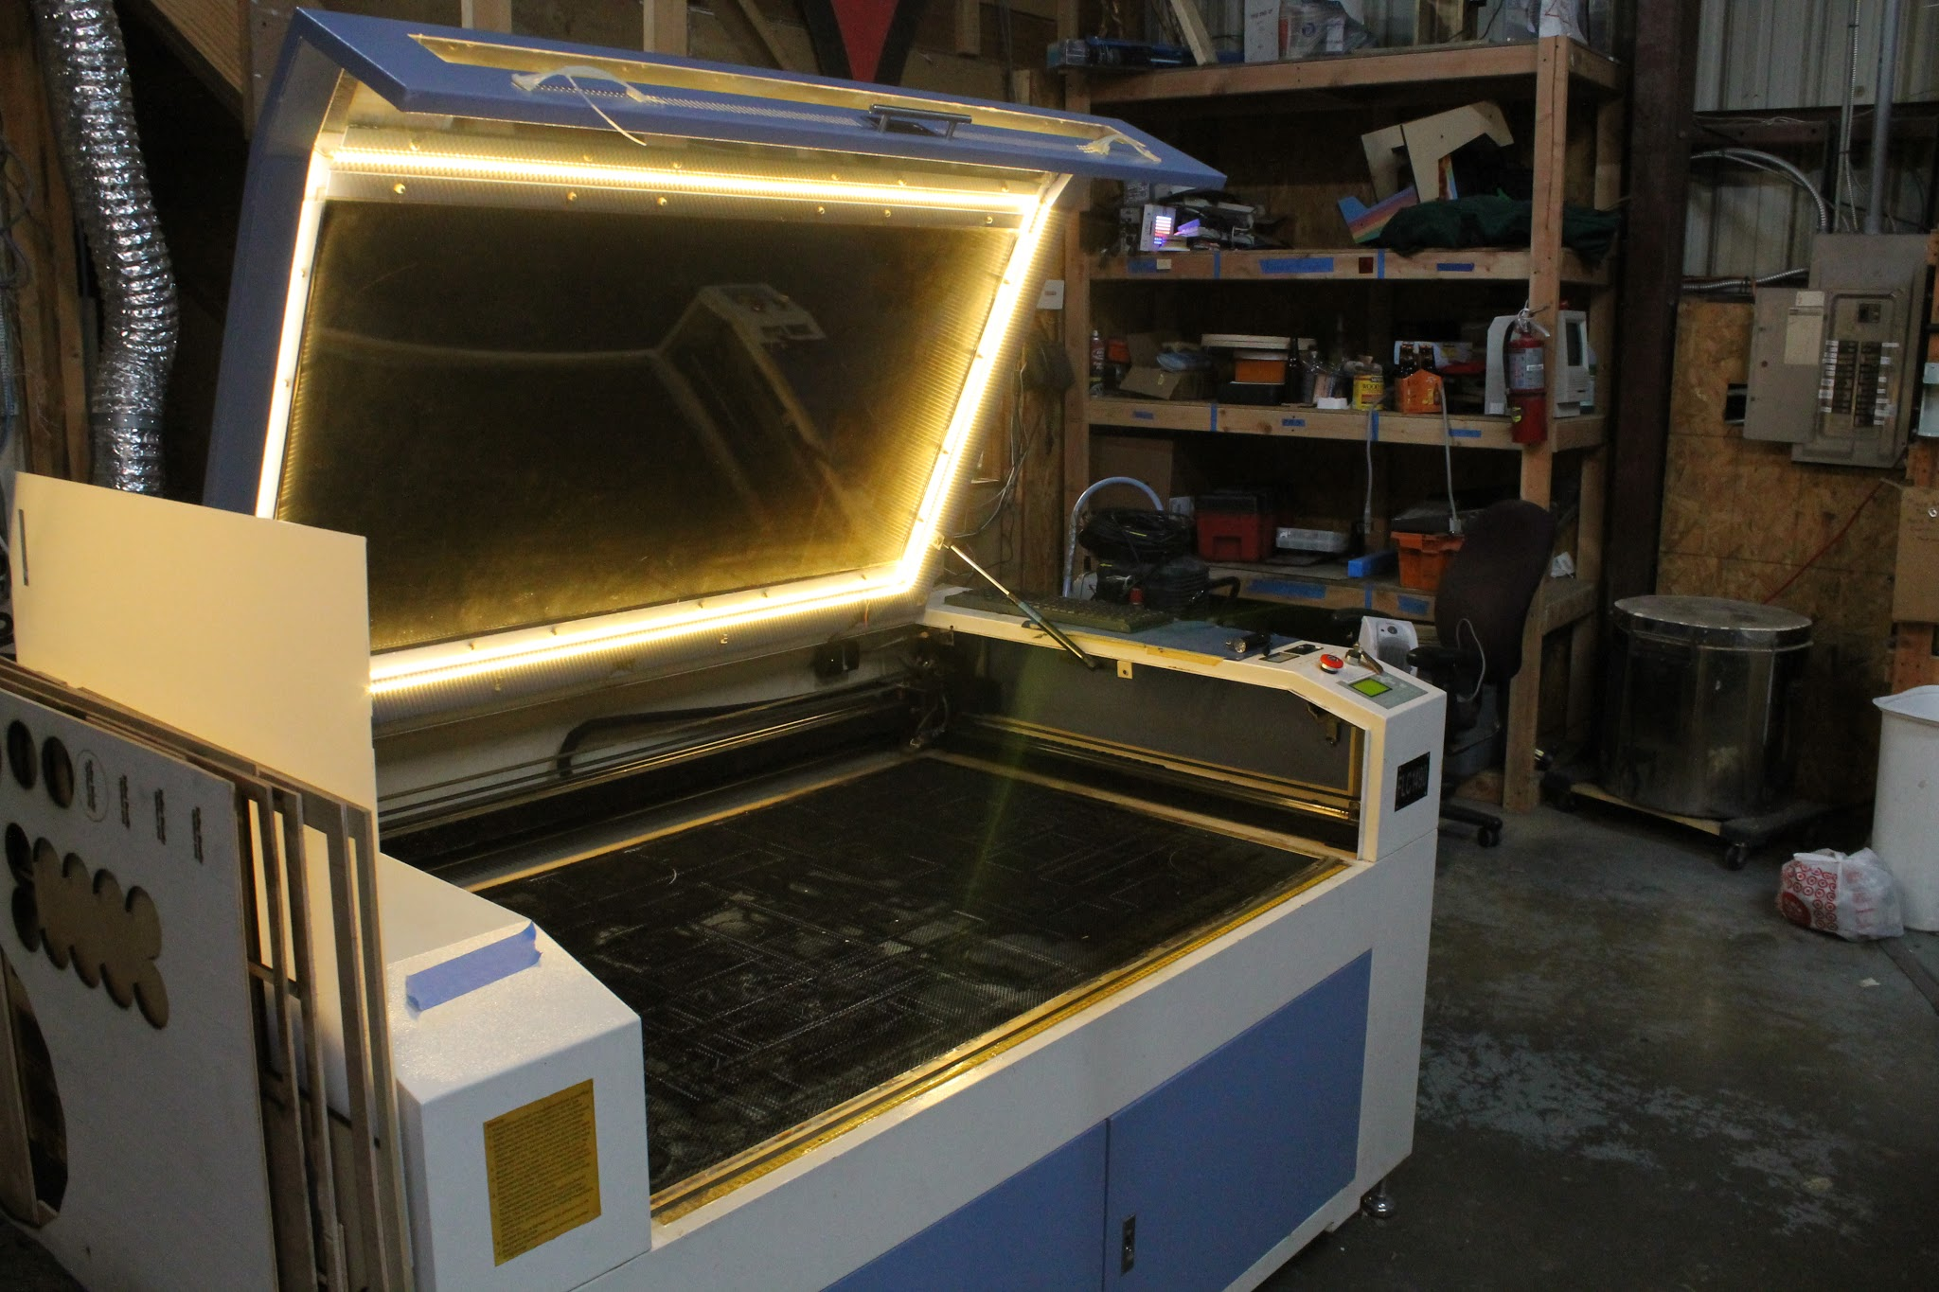
Difficulties Encountered
Laser’s focusing motor controller broke :(
Notes:
### CHRIS ###
And then the chemical laser tool we’d been prototyping on broke.. Although we still finished the fourth keyboard prototype, it slowed our progress significantly.
Next: final prototype

Slide 29
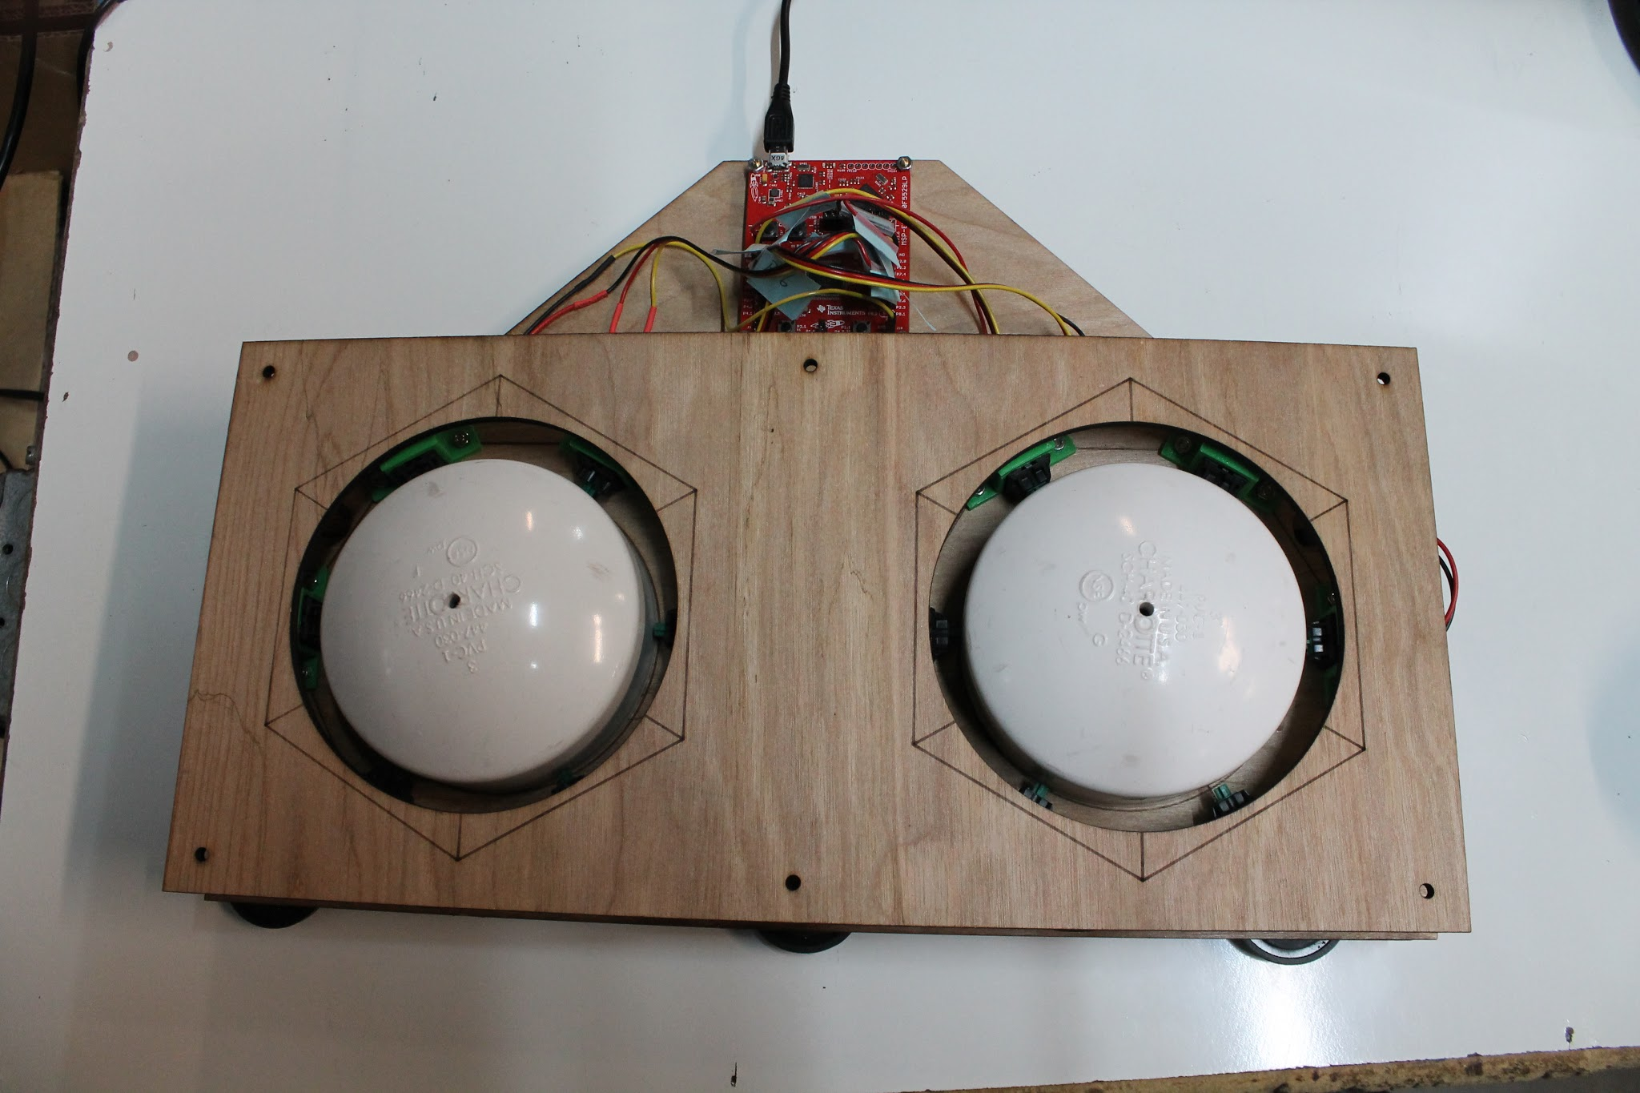
Testing and Revision
Second design revision:
Notes:
### CHRIS ###
Here is our fourth keyboard arrangement. We’ve since made the adjustments to apply orbitouch’s keymap, but haven’t constructed this final keyboard.

Slide 30
Conclusion - Keyboard
Testing response from UCP/TASC (and associates they brought in) was positive.
Design files, build instructions, and firmware are available online.
We didn’t get the keyboard to where it ought to be.
Still design changes left to test.
We still feel some legal limbo.
Notes:
### CHRIS ###
In conclusion to our keyboard’s hardware:
we learned a lot about the importance of having professional design feedback
And we can’t thank UCP and TASC enough for donating their time to help make this system viable (their words)
Next: Program flowcharts

Slide 31

System Design Description
Notes:
### CHRIS ###
Yeah, you’ve seen these 3 times now, here they are again…
Next: another flowchart

Slide 32

System Design Description
Notes:
### CHRIS ###
Last one, get a good look.
Next: AT button

Slide 33
AT Button
AT Buttons are a market standard:
Large, easy to press button.
3.5mm mono jack.
Uses range from home automation to toys.
Requested specifically by UCP/TASC:
Find a solution to a widespread market issue.
Notes:
### CHRIS ###
AT buttons use a standard 3.5mm mono cable to connect to their end devices.
During our keyboard design reviews,
TASC specifically asked us to investigate making these AT buttons,
and we felt compelled to follow up.
Next: AbleNet existing product

Slide 34
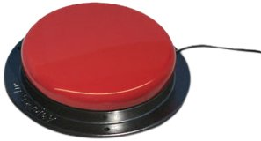
Existing Products
Ablenet Button
Range from ~$60 to ~$160
Adapting toys becomes expensive
Notes:
### CHRIS ###
We aren’t picking on any single outlet,
all retailers of these buttons charge between $60 and $160
It’s just a factor of the cost involved for injection plastic moulds and real manufacturing.
Next: DIY solutions

Slide 35
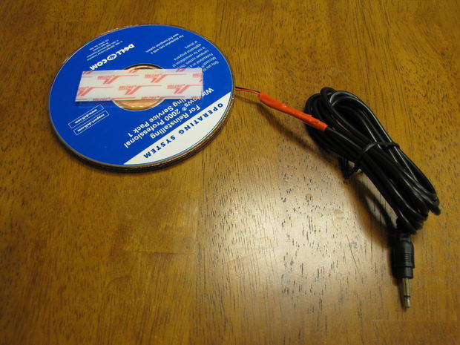
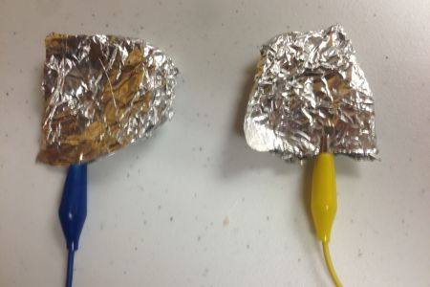
Existing Products
People wind up making their own:
http://www.instructables.com/id/CD-Switch/
https://www.diyability.org/projects/make-a-simple-capability-switch/3
Notes:
### CHRIS ###
So end users turn to DIY solutions when they want to adapt low-risk items like toys.
There are great guides online for adapting things like RC cars… there are not complementary guides for buttons.
Next: choosing a button size

Slide 36
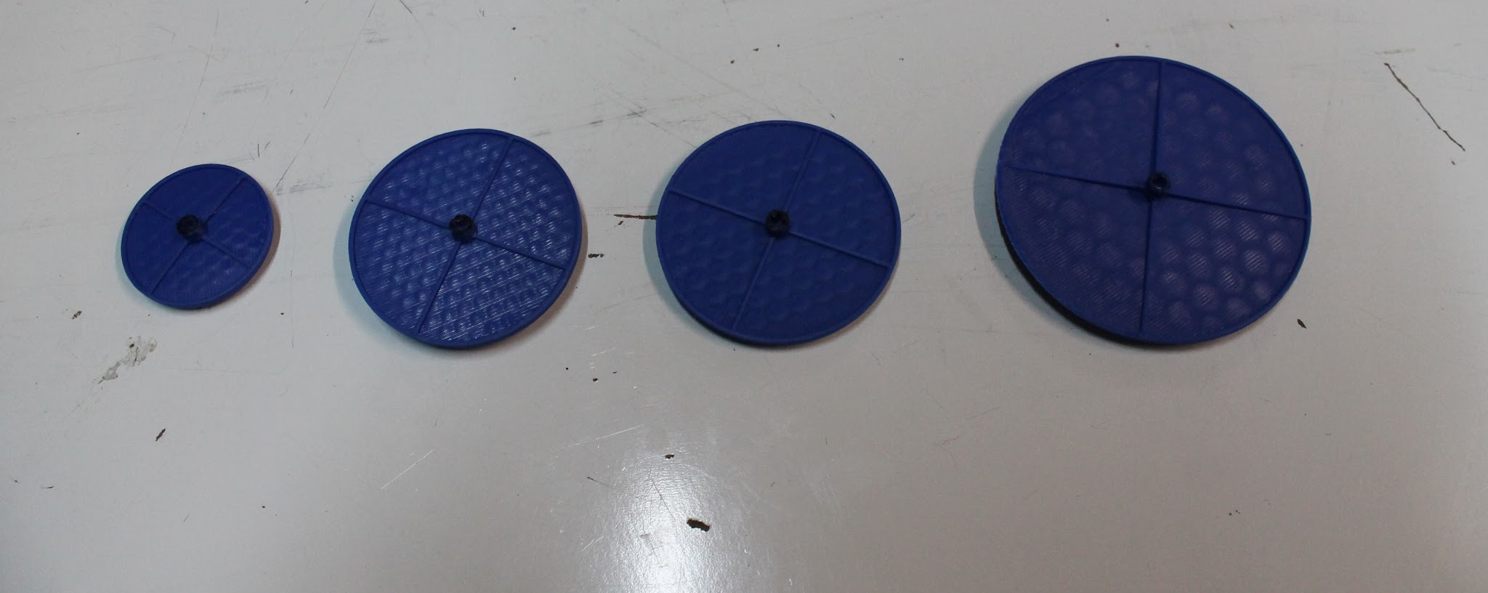
Testing and Revision
Internal testing beforehand:
The existing buttons look.. hand sized.
We settled on 100mm button diameter.
No multi-path assembly. Can only be printed.
Notes:
### CHRIS ###
We began by investigating things such as the key size.
The 100mm diameter was chosen to make a button that is hand-sized and can be printed on the vast majority of printers.
Next: warping issues

Slide 37
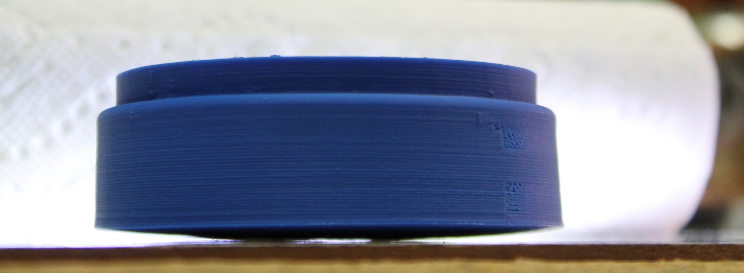
Difficulties Encountered
Immediate problems with printer
Fix it for good this time
Notes:
### CHRIS ###
Now -- bear with me -- We had a lot of obstacles to creating this button, and I want to share just one of them with you.
The part is warped and pulled off the print surface, creating this rocking button.
Next: contributing factors

Slide 38
Difficulties Encountered
Issues affecting print adhesion
Temperature (heated build plate)
Build plate material
Part design!
Notes:
### CHRIS ###
So what causes this:
Temperature (cold hot bed and molten plastic is bad)
The type of material you’re printing on
The actual design of the part
Next: build plate materials

Slide 39
Difficulties Encountered
Build plate materials tested:
Aluminum
Painters tape
Kapton tape
Polyetherimide sheet with 3M 468MP
Polyetherimide+fiberglass laminate
Borosilicate glass
Polyvinylpyrrolidone (PVP) glue slurry
PVA glue slurry
Borosilicate glass with Kapton tape
All results documented
Notes:
### CHRIS ###
We added a heater core to the print plate, and began experimenting with materials.
There were some really nice results with PolyVinylPyrroliDone glue slurry
The material we finally picked was PolyEtheriMide and fiberglass laminate.
Next: infill amount

Slide 40
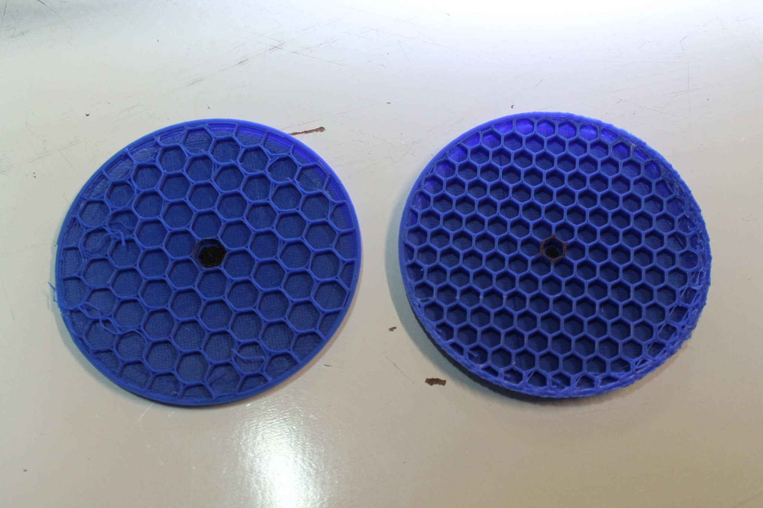
Difficulties Encountered
All-layer anti-warp:
Reduce infill connective area, reduce cooling stresses
Notes:
### CHRIS ###
We also changed the printed infill to have larger spaces, which reduces stresses accumulated while the part slowly cools.
Next: bottom layers

Slide 41
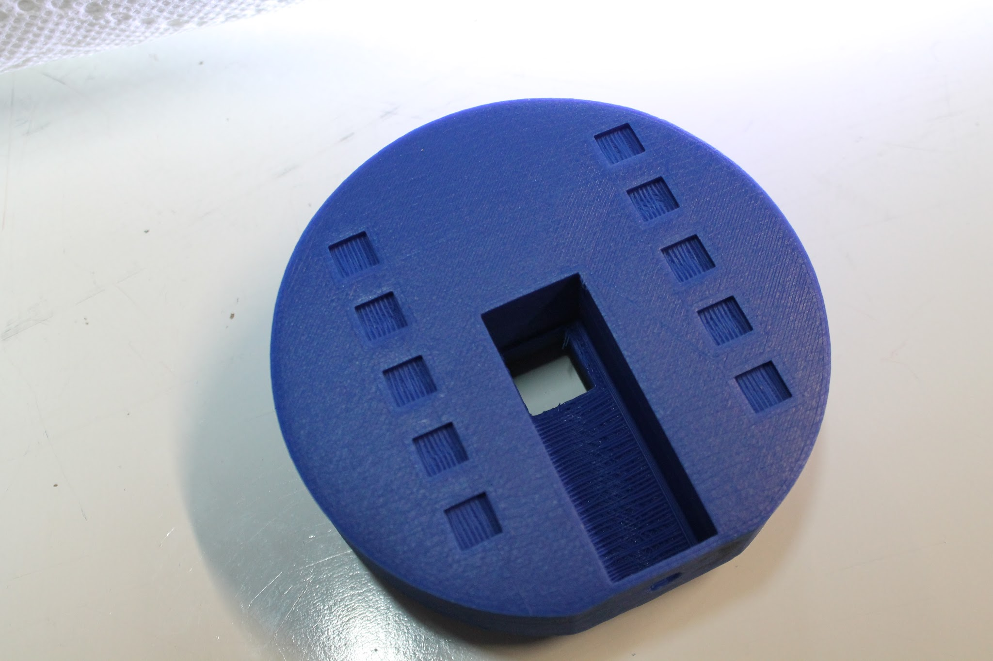
Difficulties Encountered
Two layer anti-warp design:
Reduce surface area, reduce thermal stresses
Notes:
### CHRIS ###
Lower the surface area
Next: less surface area

Slide 42
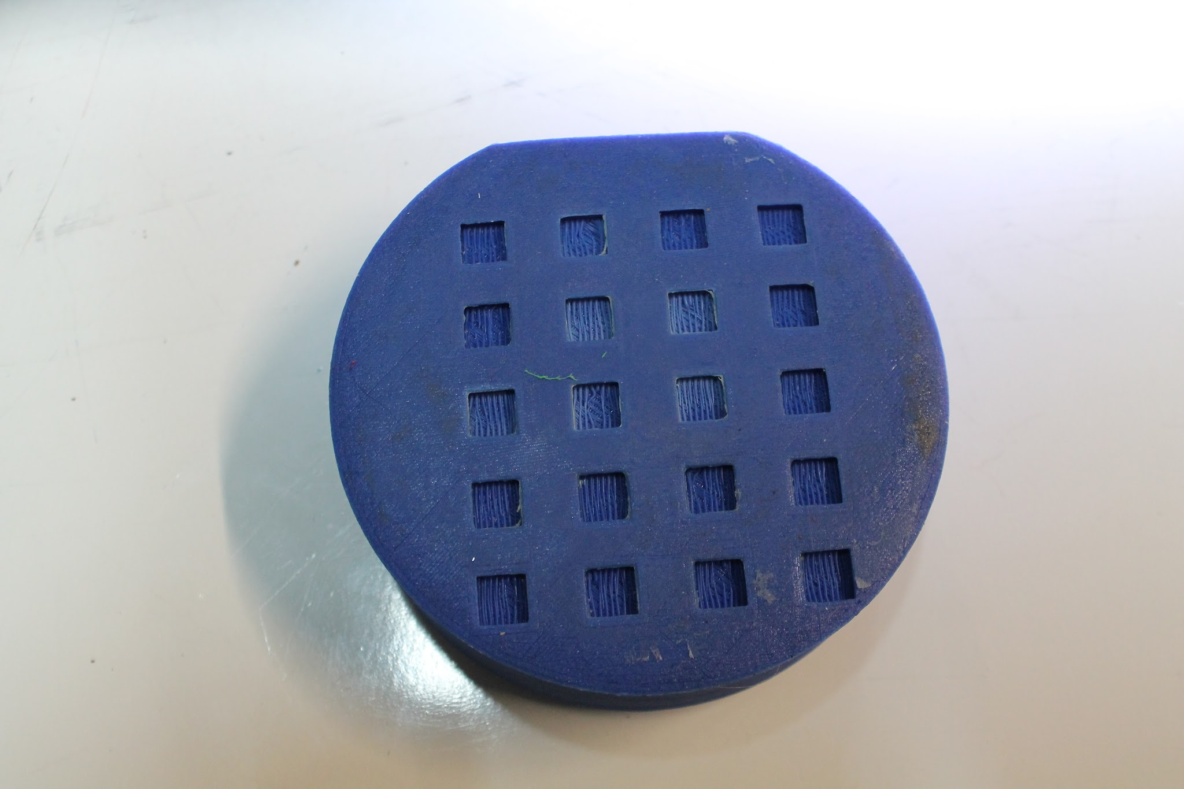
Difficulties Encountered
Two layer anti-warp design:
Reduce surface area, reduce thermal stresses
Notes:
### CHRIS ###
Lower it some more
Next: Working anti-warp

Slide 43
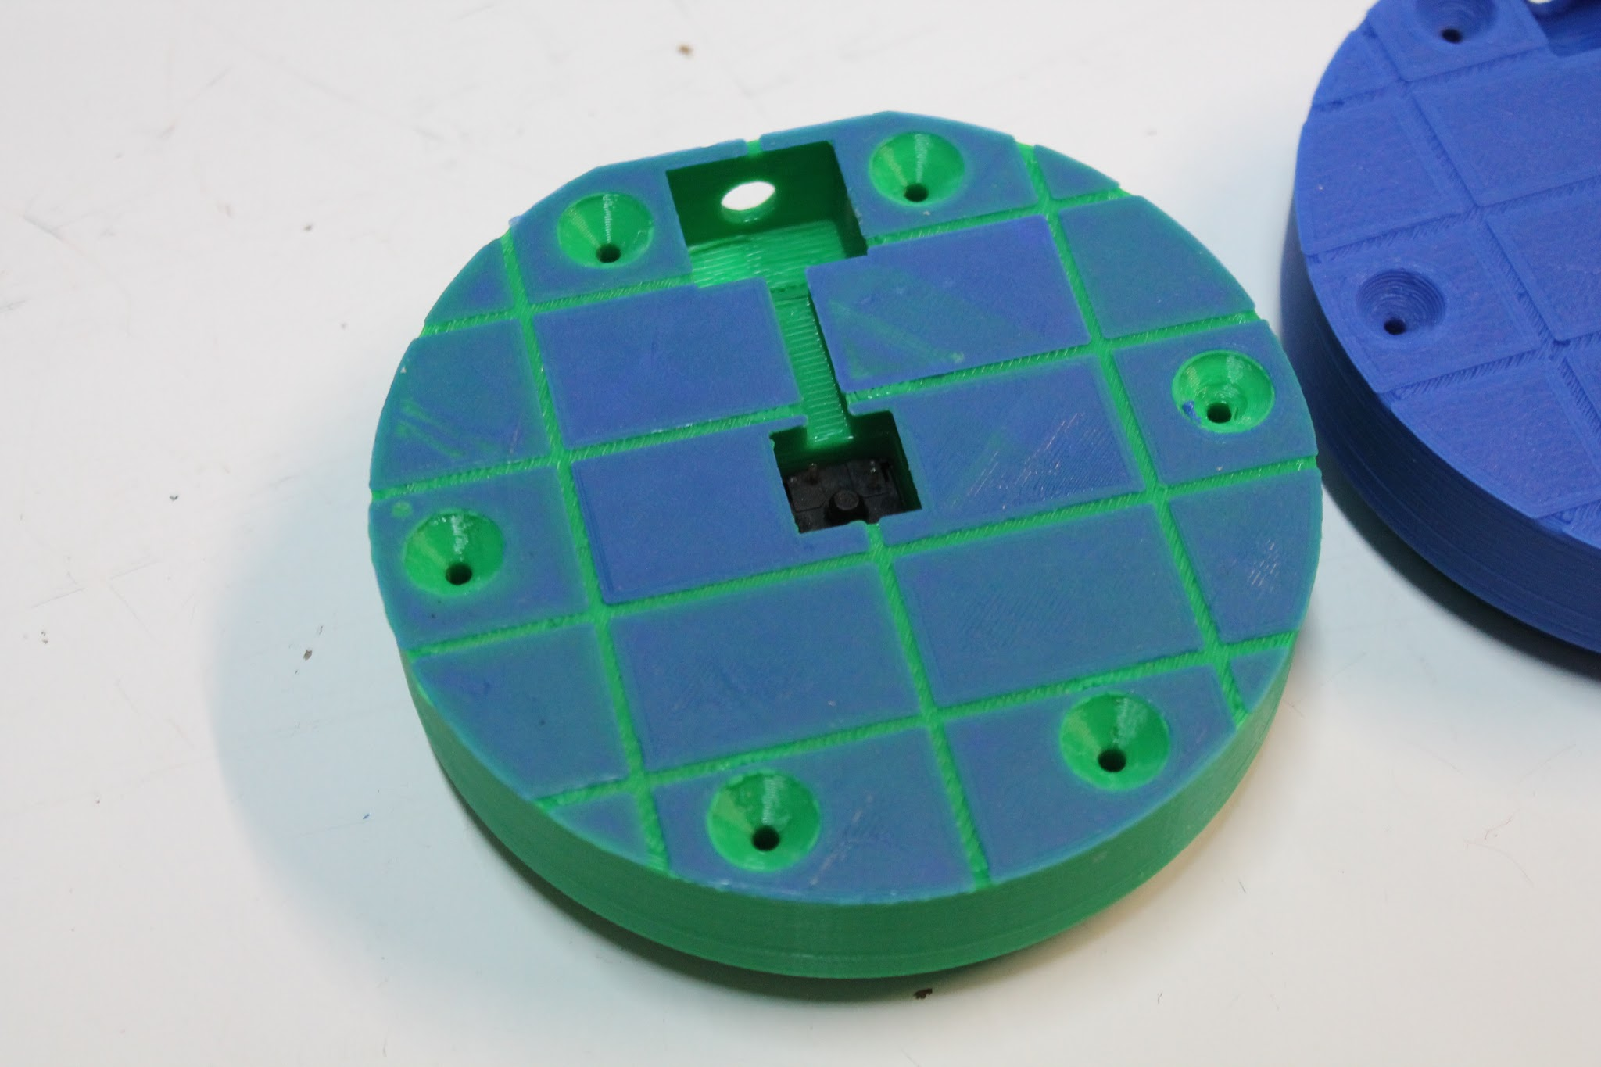
Difficulties Encountered
Two layer anti-warp design:
Reduce surface area, reduce thermal stresses
Notes:
### CHRIS ###
Finally figured out that it isn’t surface area, but maximum distance which causes print warping.
Next: warping issue fixed

Slide 44
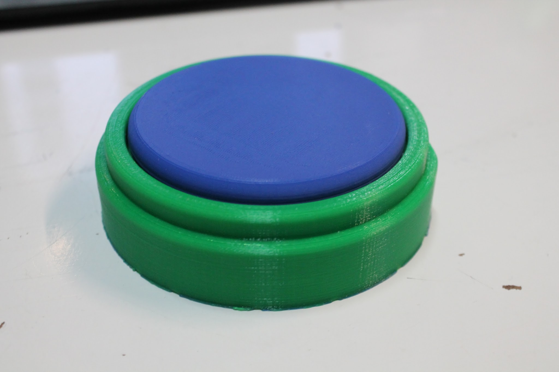
Difficulties Encountered
Result:
Final parts have printed with no visible deflection!
Notes:
### CHRIS ###
End result: parts now print with no visible deflection.
Next: first button

Slide 45
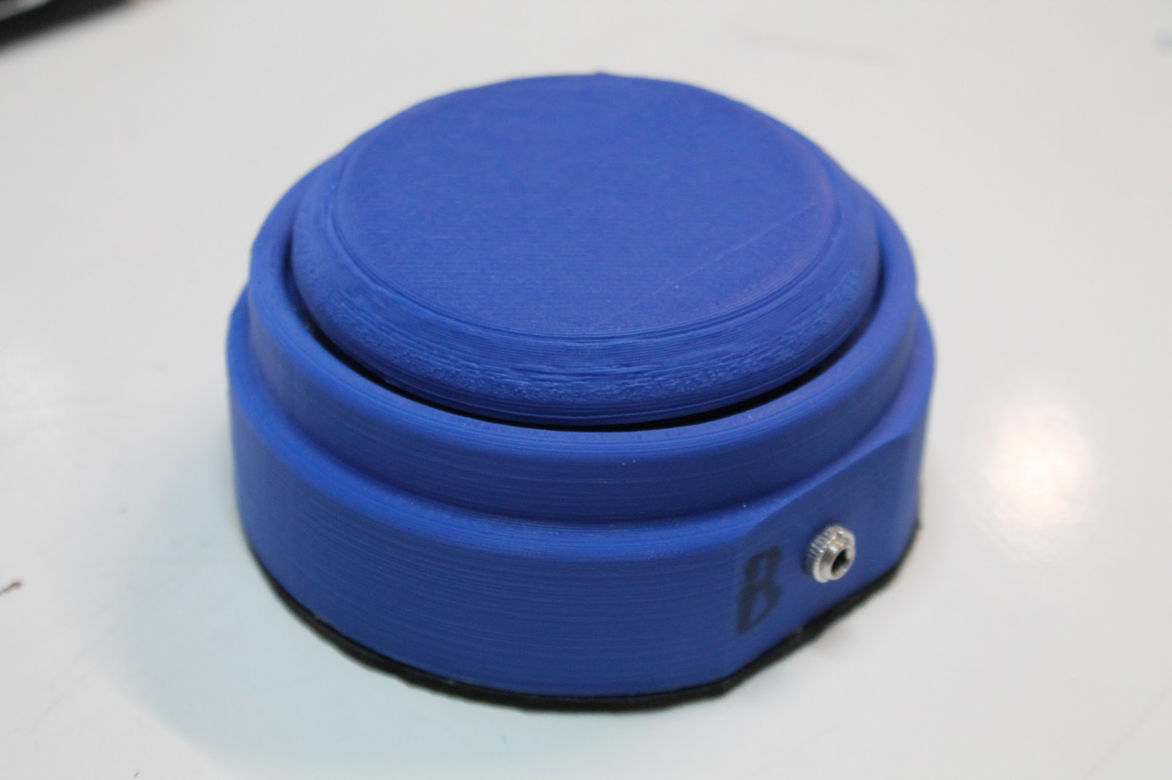
Testing and Revision
Internal testing beforehand:
First button drafted in FreeCAD
Notes:
### CHRIS ###
We designed this button in freeCAD, and printed a prototype to show TASC.
Next: design review

Slide 46
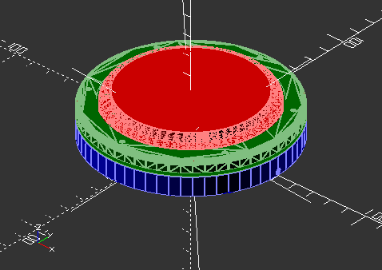
Testing and Revision
Design revision
Smaller
Actuation force 100-150g
No port, direct cable connection
Side (tilted) clicking
Re-create in SCAD
Notes:
### CHRIS ###
TASC had some adjustments,
notably, they wanted us to reduce complexity
and work on the user-device interaction.
Next: final button

Slide 47
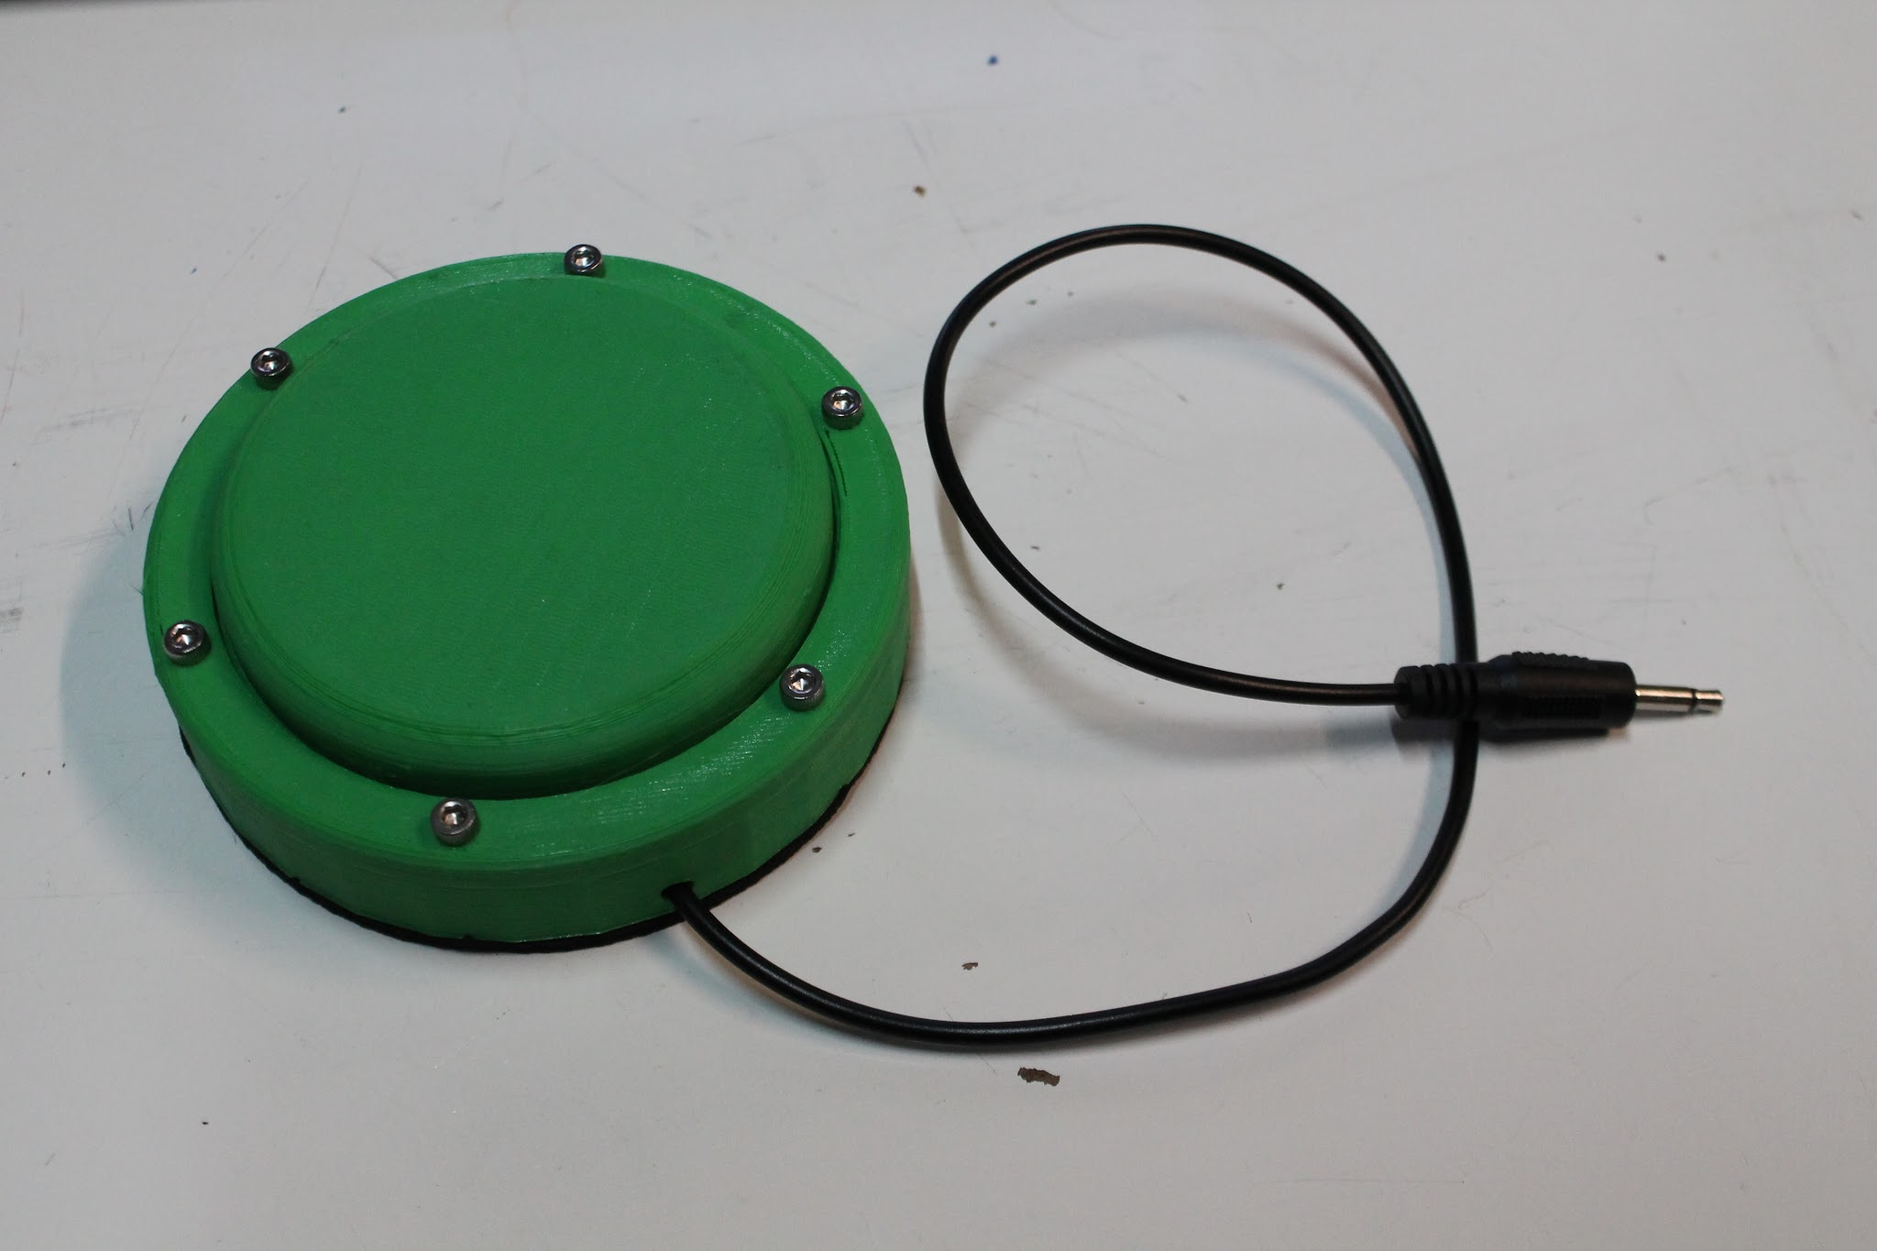
Testing and Revision
Design revision
Notes:
### CHRIS ###
This is the final keyboard
no port, the cord is attached
No complicated stabilizer springs, the button has a retainer clip instead

Slide 48
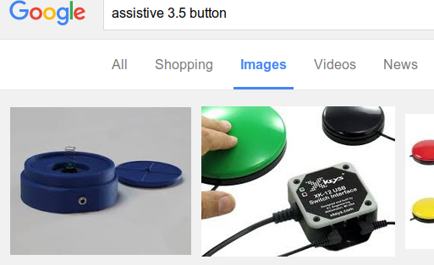
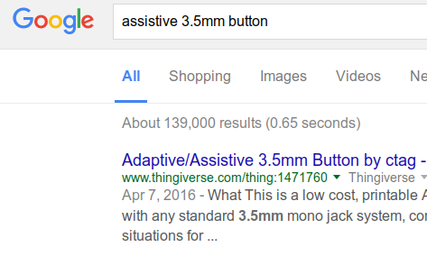
Conclusion - Button
We learned a lot about real engineering
There’s a lot of work involved in simplicity
The button design is done and online
Is the first result on Google web and images
Notes:
### CHRIS ###
We learned a lot about keeping a design simple, and the difficulties involved in making a product for a user rather than an engineer.
Next: Mike’s turn!

Slide 49
Predictive Text
It predicts the word a user is trying to enter using the characters entered so far.
The app functions both as a standalone application as well as a Chrome browser web extension.
Notes:
###Mike###
On top of our hardware solutions we have some developed software solutions to further help computer users with disabilities. We wrote an app which attempts to predict what the user is trying to type with the letters they have entered so far. The app functions both as a standalone application as well as a Chrome browser web extension.

Slide 50
Purpose
This program is helpful for anyone who is typing slowly.
Saves the user time and effort
The Chrome extension is more readily available to consumers.
Notes:
###Mike###
The purpose of the application is to make it easier for any user to type complete words into their computer. It is especially helpful for anyone who is typing slowly. If the user can type in only a few letters of a word and manage to enter the whole word that is both time and effort saved for the user. We wrote a version of the application as a Chrome extension in order to make it more readily available to consumers.

Slide 51
Logic
Both versions of the program have identical logic behind their functionality.
Text is retrieved from a keystroke listener
Database table contains two columns, one for the word and another for how often that word has been used by the user.
Notes:
###Mike###
Both versions of the program have identical logic behind their functionality. First the program listens for keystrokes from the user in order to determine the beginning of the word and writes a SQL query to a SQLite database containing the English dictionary. Each word is also associated in the database with a value representing how often the word has been the intended word. The more commonly used the word is the more likely it is to be recommended.

Slide 52
Logic
The SQL query used is:
“SELECT WORD FROM dictionary WHERE WORD LIKE '" + arg + "%' ORDER BY COUNT DESC LIMIT 5;”
This query returns 5 values in order of the likelihood that they are the intended word.
Notes:
###Mike###
And with that end I will let John talk about the project’s progression

Slide 53
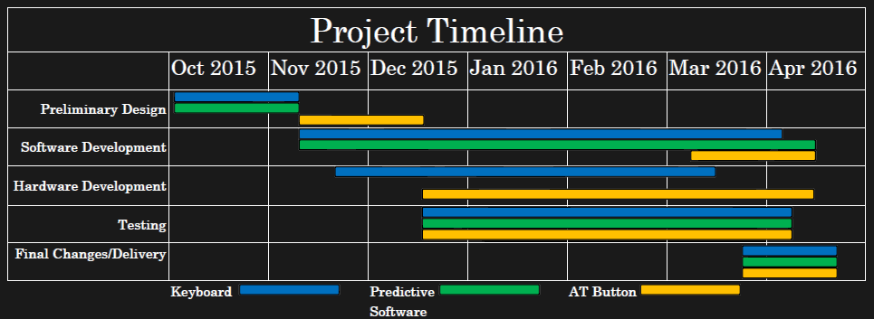
Timeline
Notes:
###John###
Here you can see the flow of our projects.
Beginning with last semester we held our Preliminary design
Notably in November TASC requested for us to create the AT Button
Since November we consistently developed software for the Keyboard and Predictive Text Program up until March
As Chris had mentioned, up until then we were developing heavily on the Keyboard until the Laser Cutter had malfunctions
From that time up to today, we have been focused on improving the AT Button.

Slide 54
Timeline
October—Continue Research and establish contact with our customer.
November—Begin Construction for our Keyboard prototype. Begin AT Button.
December—Evaluating Go/No Go milestone.
January—Continue the development of hardware/software systems.
February—Integration testing between the hardware and software.
March—Implement final changes.
April—Deliver products to TASC.
Notes:
###John###
Here you can see the flow of our projects.
Beginning with last semester we held our Preliminary design
Notably in November TASC requested for us to create the AT Button
Since November we consistently developed software for the Keyboard and Predictive Text Program up until March
As Chris had mentioned, up until March we were developing heavily on the Keyboard until the Laser Cutter had malfunctions
Again since March--up to today, we have been focused on improving the AT Button.

Slide 55
Development Costs
October — $93.72 Development Boards, Microcontrollers
November — $19.48 Mono socket cables
December — $144.32 Plywood and Acrylic sheets
January — $88.42 Switches, Bolts
February — $35.68 Test Hardware
March — $49.55 Test Hardware
April — $39.24 Packaging
TOTAL COST: $470.41 *More in depth on our Github
Notes:
### JOHN ###
Here we have a summary of our expenses for each month with the most notable purchases outlined therein.
In the end, costs for prototyping the various stages totaled to about $470 in development to reach the final project.

Slide 56
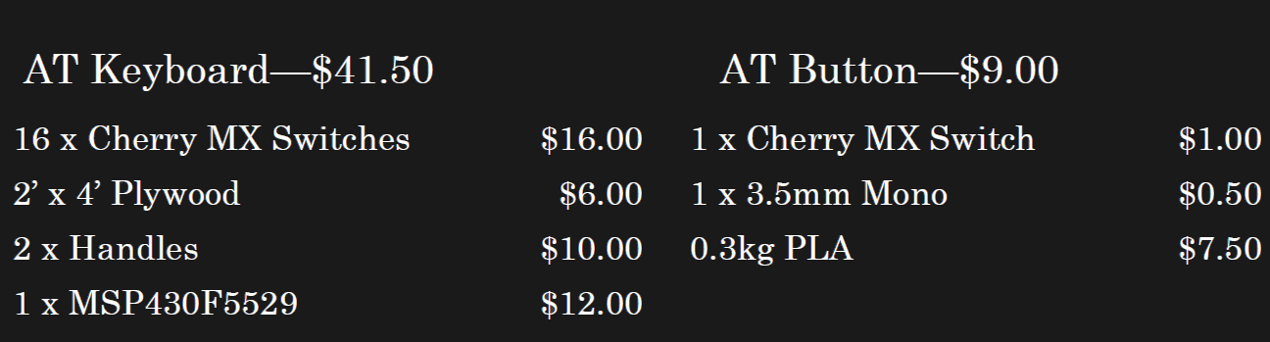
Approximated Product Costs
Notes:
### JOHN ###
Listed here we have our approximate final product costs for anyone who wishes to build the systems on their own
The keyboard is 41.50
The button is 9.00

Slide 57
Course Conclusion
The team plans to deliver all finished hardware and software to UCP/TASC
The keyboard design, as well as the button schematic, has been released online.
A separate company has already expressed interest in the continued development of our AT button.
Notes:
### JOHN ###
UCP was delighted with the final version of the button: as a result, we plan to create and donate a shipment of the buttons as thanks for their involvement.
The keyboard designs are open and have been released: they are primed and ready for anyone who wants to use or improve them.
In addition, the team was contacted by an outside group showing interest in the button.

Slide 58
Questions/Comments?
Notes:
This concludes our presentation, are there any questions? ### FREE ###
Last person speaking says: “Thank you for your time!”

